Slide 1
Using the tangent ratio
Trigonometry

Slide 2
How our teaching resources are designed for the classroom

Slide 3
I can use the tangent ratio to find the missing side or angle in a right-angled triangle.

Slide 4
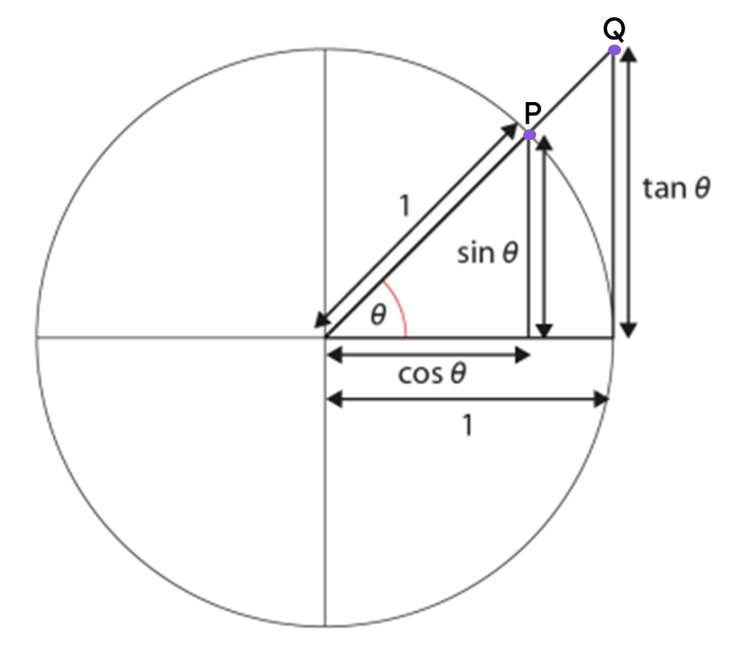
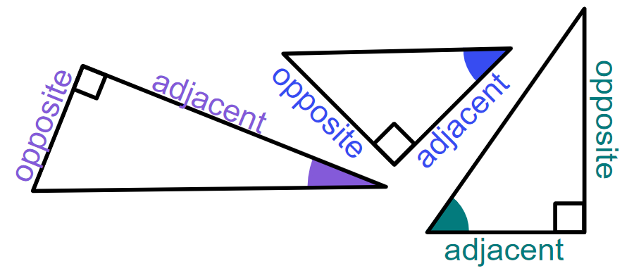
Trigonometric functions are commonly defined as ratios of two sides of a right-angled triangle containing the angle.
The tangent of an angle (tan(θ°)) is the y-coordinate of point Q of the triangle which extends from the unit circle.
The adjacent side of a right-angled triangle is the side which is next to both the right angle and the marked angle.
The opposite side of a right-angled triangle is the side which is opposite the marked angle.

Slide 5

Using the tangent ratio
Formalising the tangent formula
Calculating the angle

Slide 6
Formalising the tangent formula
We know that these two triangles are similar, as two of the angles in one triangle are equal to two angles in the other.
We can find the length of the side labelled x by using a ratio table.
× 0.67
1
0.67
× 12
× 12
12
0.67 × 12
8.04
8.04 cm
× 0.67
x cm
0.67 cm
42°
42°
× 12
12 cm
1 cm

Slide 7
Formalising the tangent formula
We can also generalise this process to any right-angled triangle that has an angle θ°, where the side opposite θ° has length tan(θ°).
× tan(θ°)
1
tan(θ°)
× a
× a
a
a × tan(θ°)
opp
× tan(θ°)
a × tan(θ°)
opp
tan(θ°)
θ°
θ°
× a
1 cm
a cm

Slide 8
Formalising the tangent formula
We can also generalise this process to any right-angled triangle that has an angle θ°, where the side opposite θ° has length tan(θ°).
1
tan(θ°)
a
opp
opp
a × tan(θ°)
a × tan(θ°)
× tan(θ°)
θ°
a cm
The length of the adjacent
multiplied by the tangent of an angle of θ°
equals the length of the side opposite that angle.

Slide 9
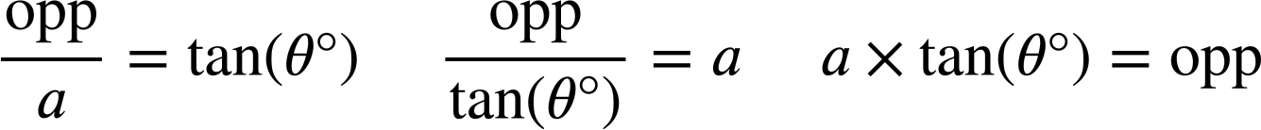
Formalising the tangent formula
We can use this ratio table to generate a formula that shows the relationship between the side opposite angle θ° and the adjacent, and represent that formula in three ways.
× tan(θ°)
The tangent formula
1
tan(θ°)
tan(θ°)
× a
× a
÷ a
a
opp
a
opp
× tan(θ°)
÷ tan(θ°)
× tan(θ°)
a × tan(θ°)
opposite
θ°
a cm

Slide 10
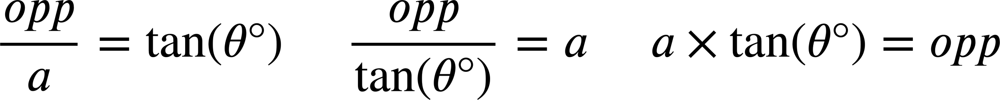
Formalising the tangent formula
We can also derive two versions of the formula given one of the others by performing a division.

Slide 11
Formalising the tangent formula
We can substitute values in a right-angled triangle into each version of the tangent formula to represent the relationship between the side opposite an angle and the adjacent in different ways.
b × tan(67°) = 16
16
16 cm
= b
tan(67°)
67°
16
b cm
= tan(67°)
b

Slide 12



Formalising the tangent formula
One correct equation showing the relationship between the adjacent and side opposite the 38° angle is:
1
tan(θ°)
× 20
× 20
20
opp
× tan(38°)
Which of these also correctly shows the relationship between the adjacent and opposite side of this triangle?
a
opp
38°
b
20 cm

Slide 13
Formalising the tangent formula
Which of these correctly shows the relationship between the adjacent and the side opposite the 82° angle for this triangle (rounded to the nearest integer)?
a
d
70 cm
b
e
82°
c
10 cm

Slide 14
Formalising the tangent formula
In each version of the formula, a different part of the triangle is written as the subject.
It is helpful to use the version of the formula whose subject matches the part of the triangle you are trying to find the value of.
55°
85 × tan(55°) = p
p cm
85 cm
p = 121.39 (2 d.p.)
opp
adj
We want to find the value of p, the length of the side opposite to an angle of 55°.

Slide 15
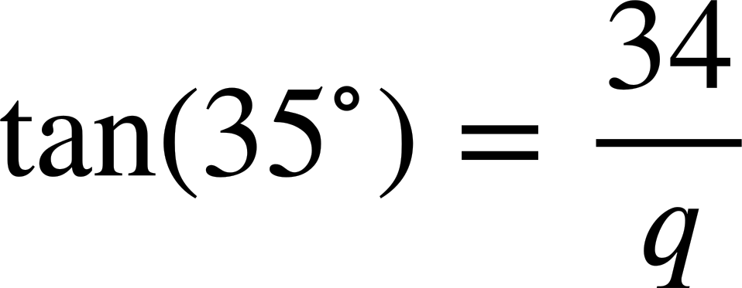
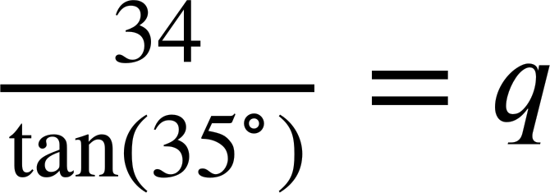
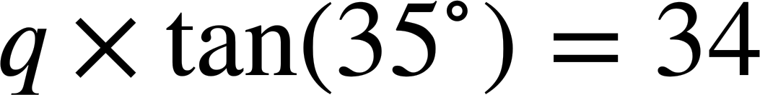
Formalising the tangent formula
Which of these equations helps find the value of q most efficiently?
Hence, find the length of the side labelled q (2 d.p.)
a
48.56 m
q m
34 m
b
q = 48.56
35°
c

Slide 16
Formalising the tangent formula
1) Substitute the labelled sides and angle in each triangle into these two versions of the tangent formula.
For each triangle, choose the most appropriate version of the tangent formula to find the length of its missing side.
× tan( ) =
× tan( ) =
49°
119 cm
2 cm
b cm
=
=
tan( )
tan( )
81°
a cm

Slide 17
Formalising the tangent formula
2) Match the triangle to the equation showing the relationship between its adjacent and the opposite side.
Use the equation to find the length of the missing side labelled x on each triangle (2 d.p.)
a)
b)
c)
50°
32°
32 cm
x cm
x cm
32°
50 cm
x cm
50 cm
x × tan(32°) = 50
d
50 × tan(32°) = x
e
32 × tan(50°) = x
f

Slide 18
Formalising the tangent formula
3) By using the tangent formula, find the length of the missing side labelled with a letter for each of these triangles (2 d.p.)
a)
b)
c)
a cm
b cm
c cm
39°
39°
49°
1 cm
14.9 cm
14.9 cm
d)
e)
f)
41°
e cm
14.9 cm
49 cm
49°
14.9°
d cm
14.9 cm
f cm

Slide 19
Formalising the tangent formula
4) Find the lengths of the distances a, b, c, and d (rounded to the nearest integer).
64 cm
c cm
39.5 cm
a cm
27°
50 cm
b cm
10 cm
d cm

Slide 20
Formalising the tangent formula
1) Substitute the labelled sides and angle in each triangle into these two versions of the tangent formula.
For each triangle, choose the most appropriate version of the tangent formula to find the length of its missing side.
× tan( ) =
× tan( ) =
a
81°
119
2
49°
b
49°
119
119 cm
b
2 cm
b cm
a
2
=
=
tan( )
tan( )
81°
49°
81°
a cm = 18.85 cm
b cm = 2.30 cm
a cm

Slide 21
Formalising the tangent formula
2) Match the triangle to the equation showing the relationship between its adjacent and the opposite side.
Use the equation to find the length of the missing side labelled x on each triangle (2 d.p.)
a)
b)
c)
50°
32°
32 cm
x cm
x cm
32°
50 cm
x cm
50 cm
50 × tan(32°) = x
e
32 × tan(50°) = x
f
x × tan(32°) = 50
d
x = 31.24
x = 38.14
x = 80.02
The side opposite 32° has a length of 31.24 cm
The side opposite 50° has a length of 38.14 cm
The adjacent has a length of 80.02 cm

Slide 22
Formalising the tangent formula
3) By using the tangent formula, find the length of the missing side labelled with a letter for each of these triangles (2 d.p.)
a)
b)
c)
a cm
b cm
c cm
39°
39°
49°
1 cm
a = 0.81
14.9 cm
b = 12.07
14.9 cm
c = 17.14
d)
e)
f)
41°
e cm
14.9 cm
49 cm
49°
49°
14.9°
d cm
14.9 cm
f cm
d = 12.95
e = 17.14
f = 184.16

Slide 23
Formalising the tangent formula
4) Find the lengths of the distances a, b, c, and d (rounded to the nearest integer).
45 cm
64 cm
c cm
25 cm
39.5 cm
a cm
27°
50 cm
b cm
10 cm
d cm
28 cm
38 cm

Slide 24
Using the tangent ratio
Formalising the tangent formula
Calculating the angle

Slide 25
Calculating the angle
angle | sine | cosine | tangent
0 | 0 | 1 | 0
5 | 0.087 | 0.996 | 0.087
10 | 0.174 | 0.985 | 0.176
15 | 0.259 | 0.966 | 0.268
20 | 0.342 | 0.94 | 0.364
25 | 0.423 | 0.906 | 0.466
30 | 0.5 | 0.866 | 0.577
35 | 0.574 | 0.819 | 0.7
40 | 0.643 | 0.766 | 0.839
45 | 0.707 | 0.707 | 1
50 | 0.766 | 0.643 | 1.192
55 | 0.819 | 0.574 | 1.428
60 | 0.866 | 0.5 | 1.732
65 | 0.906 | 0.423 | 2.145
70 | 0.94 | 0.342 | 2.747
75 | 0.966 | 0.259 | 3.732
80 | 0.985 | 0.174 | 5.671
85 | 0.996 | 0.087 | 11.43
90 | 1 | 0 | ∞
opp
tan (𝜃°) =
0.7 units
adj
𝜃°
0.7
tan (𝜃°) =
1
1 unit
What is the size of angle 𝜃° given the ratio between the opposite and adjacent is 0.7 : 1?
𝜃° = 35°

Slide 26
Calculating the angle
angle | sine | cosine | tangent
0 | 0 | 1 | 0
5 | 0.087 | 0.996 | 0.087
10 | 0.174 | 0.985 | 0.176
15 | 0.259 | 0.966 | 0.268
20 | 0.342 | 0.94 | 0.364
25 | 0.423 | 0.906 | 0.466
30 | 0.5 | 0.866 | 0.577
35 | 0.574 | 0.819 | 0.7
40 | 0.643 | 0.766 | 0.839
45 | 0.707 | 0.707 | 1
50 | 0.766 | 0.643 | 1.192
55 | 0.819 | 0.574 | 1.428
60 | 0.866 | 0.5 | 1.732
65 | 0.906 | 0.423 | 2.145
70 | 0.94 | 0.342 | 2.747
75 | 0.966 | 0.259 | 3.732
80 | 0.985 | 0.174 | 5.671
85 | 0.996 | 0.087 | 11.43
90 | 1 | 0 | ∞
opp
tan (𝜃°) =
2.184 units
adj
𝜃°
2.184
tan (𝜃°) =
6
6 units
tan (𝜃°) = 0.364
Which angle would give a value of 0.364 for tan (𝜃°)?
𝜃° = 20°

Slide 27
Calculating the angle
angle | sine | cosine | tangent
0 | 0 | 1 | 0
5 | 0.087 | 0.996 | 0.087
10 | 0.174 | 0.985 | 0.176
15 | 0.259 | 0.966 | 0.268
20 | 0.342 | 0.94 | 0.364
25 | 0.423 | 0.906 | 0.466
30 | 0.5 | 0.866 | 0.577
35 | 0.574 | 0.819 | 0.7
40 | 0.643 | 0.766 | 0.839
45 | 0.707 | 0.707 | 1
50 | 0.766 | 0.643 | 1.192
55 | 0.819 | 0.574 | 1.428
60 | 0.866 | 0.5 | 1.732
65 | 0.906 | 0.423 | 2.145
70 | 0.94 | 0.342 | 2.747
75 | 0.966 | 0.259 | 3.732
80 | 0.985 | 0.174 | 5.671
85 | 0.996 | 0.087 | 11.43
90 | 1 | 0 | ∞
opp
tan (𝜃°) =
2.563 units
adj
𝜃°
2.563
tan (𝜃°) =
5.5
5.5 units
tan (𝜃°) = 0.466
Which angle would give a value of 0.466 for tan (𝜃°)?
𝜃° = 25°
25°

Slide 28
Calculating the angle
angle | sine | cosine | tangent
0 | 0 | 1 | 0
5 | 0.087 | 0.996 | 0.087
10 | 0.174 | 0.985 | 0.176
15 | 0.259 | 0.966 | 0.268
20 | 0.342 | 0.94 | 0.364
25 | 0.423 | 0.906 | 0.466
30 | 0.5 | 0.866 | 0.577
35 | 0.574 | 0.819 | 0.7
40 | 0.643 | 0.766 | 0.839
45 | 0.707 | 0.707 | 1
50 | 0.766 | 0.643 | 1.192
55 | 0.819 | 0.574 | 1.428
60 | 0.866 | 0.5 | 1.732
65 | 0.906 | 0.423 | 2.145
70 | 0.94 | 0.342 | 2.747
75 | 0.966 | 0.259 | 3.732
80 | 0.985 | 0.174 | 5.671
85 | 0.996 | 0.087 | 11.43
90 | 1 | 0 | ∞
opp
tan (𝜃°) =
adj
22.392units
tan (𝜃°) =
22.392
6
𝜃°
tan (𝜃°) = 3.732
6 units
Which angle would give a value of 3.732 for tan(𝜃°)?
𝜃° = 75°

Slide 29
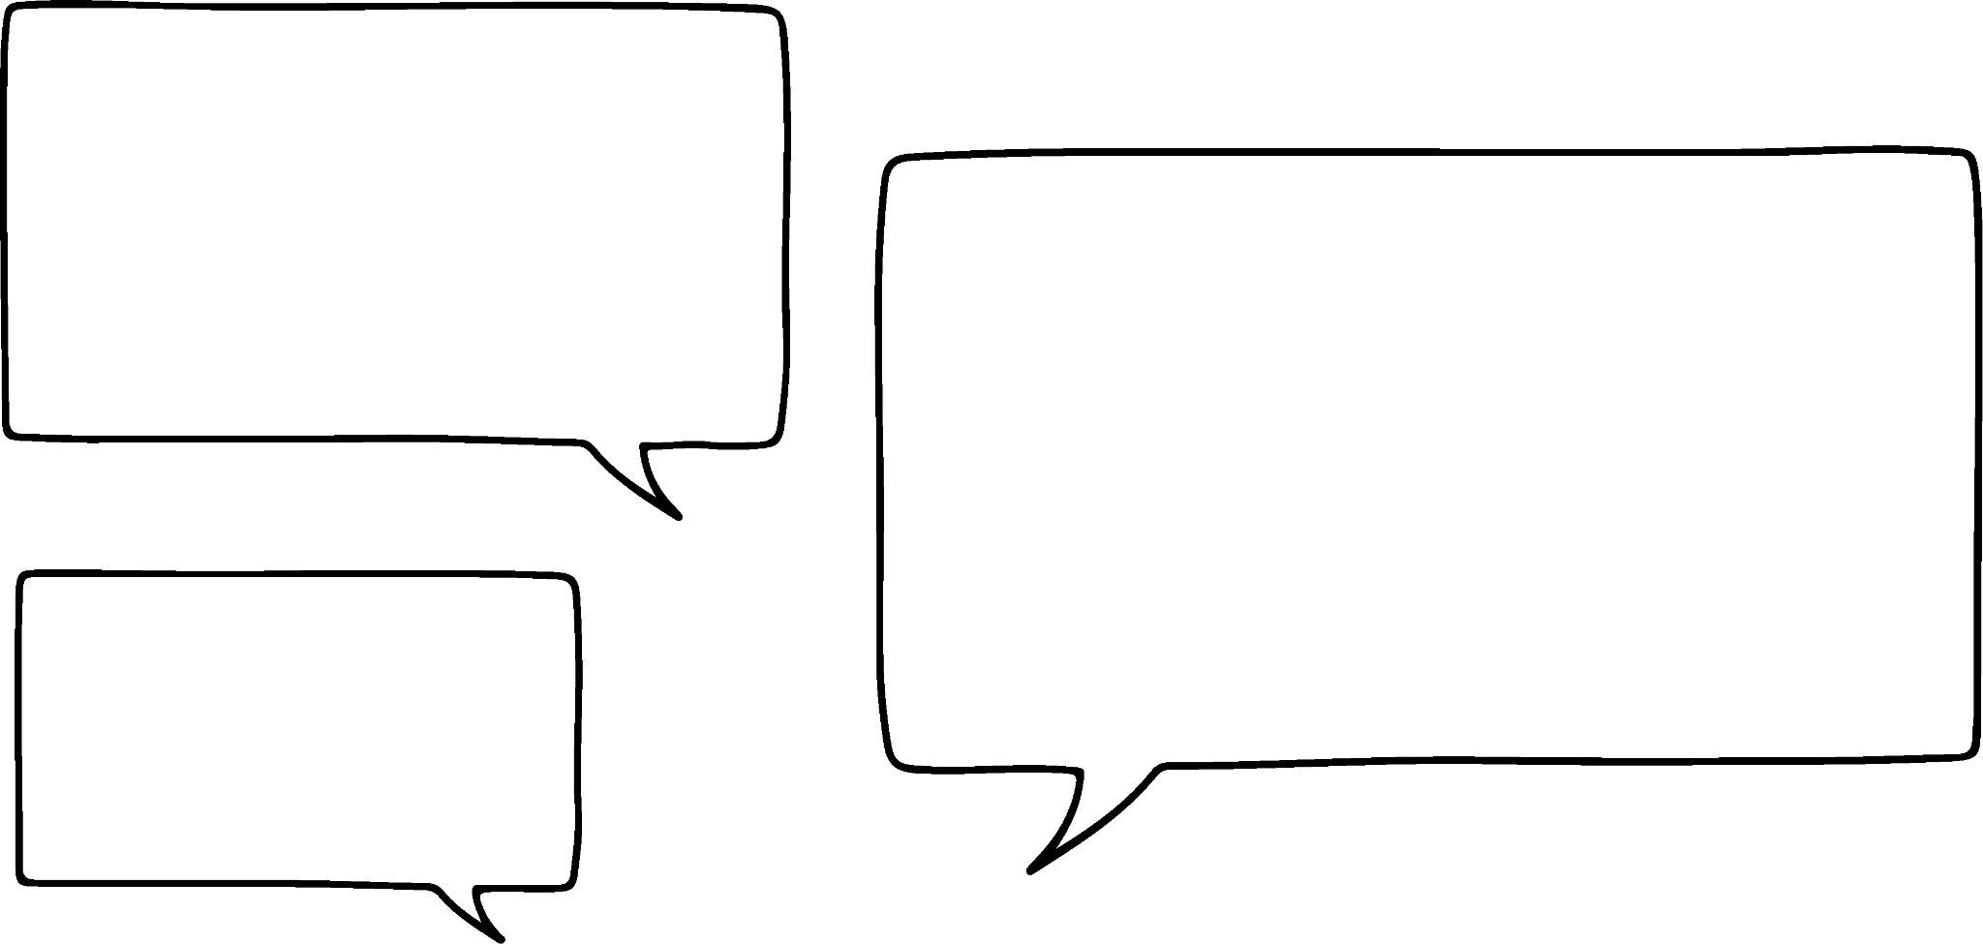

Calculating the angle
angle | sine | cosine | tangent
0 | 0 | 1 | 0
5 | 0.087 | 0.996 | 0.087
10 | 0.174 | 0.985 | 0.176
15 | 0.259 | 0.966 | 0.268
20 | 0.342 | 0.94 | 0.364
25 | 0.423 | 0.906 | 0.466
30 | 0.5 | 0.866 | 0.577
35 | 0.574 | 0.819 | 0.7
40 | 0.643 | 0.766 | 0.839
45 | 0.707 | 0.707 | 1
50 | 0.766 | 0.643 | 1.192
55 | 0.819 | 0.574 | 1.428
60 | 0.866 | 0.5 | 1.732
65 | 0.906 | 0.423 | 2.145
70 | 0.94 | 0.342 | 2.747
75 | 0.966 | 0.259 | 3.732
80 | 0.985 | 0.174 | 5.671
85 | 0.996 | 0.087 | 11.43
90 | 1 | 0 | ∞
How do we find angles that are not in that table?
22.392units
𝜃°
6 units
Aisha
Which angle would give a value of 3.732 for tan(𝜃°)?
𝜃° = 75°
We can use the unit circle to find more angles.

Slide 30
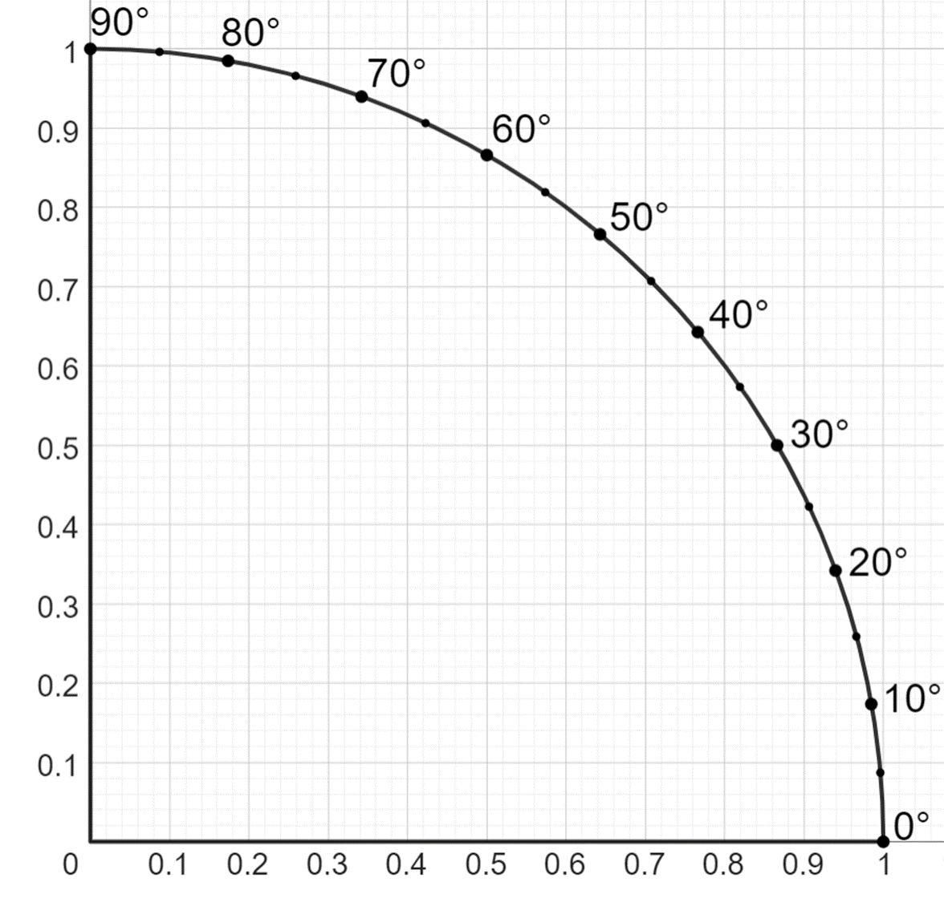
Calculating the angle
angle | sine | cosine | tangent
0 | 0 | 1 | 0
5 | 0.087 | 0.996 | 0.087
10 | 0.174 | 0.985 | 0.176
15 | 0.259 | 0.966 | 0.268
20 | 0.342 | 0.94 | 0.364
25 | 0.423 | 0.906 | 0.466
30 | 0.5 | 0.866 | 0.577
35 | 0.574 | 0.819 | 0.7
40 | 0.643 | 0.766 | 0.839
45 | 0.707 | 0.707 | 1
50 | 0.766 | 0.643 | 1.192
55 | 0.819 | 0.574 | 1.428
60 | 0.866 | 0.5 | 1.732
65 | 0.906 | 0.423 | 2.145
70 | 0.94 | 0.342 | 2.747
75 | 0.966 | 0.259 | 3.732
80 | 0.985 | 0.174 | 5.671
85 | 0.996 | 0.087 | 11.43
90 | 1 | 0 | ∞
30°

Slide 31
Calculating the angle
0.5 unit
𝜃°
1.2 unit
opp
approximately 22.5°
tan (𝜃°) =
adj
0.5
tan (𝜃°) =
1.2
tan (𝜃°) = 0.417
𝜃°

Slide 32
Calculating the angle
1 unit
𝜃°
1.4 units
opp
approximately 35.5°
tan (𝜃°) =
adj
1
tan (𝜃°) =
1.4
𝜃°
tan (𝜃°) = 0.714

Slide 33
Calculating the angle
1.5 unit
𝜃°
1.8 unit
opp
approximately
tan (𝜃°) =
39.8
adj
°
1.5
tan (𝜃°) =
1.8
𝜃°
tan (𝜃°) = 0.833

Slide 34
Calculating the angle
Okay, but this method isn’t very accurate.
There must be another way, that doesn’t rely on a table or a graph and is more accurate.
Aisha

Slide 35
Calculating the angle
opposite
The tangent function, tan (𝜃°), returns the ratio for a given value of 𝜃°.
adjacent
If you can find the ratio from the angle it is possible to use the inverse to find the angle from a given ratio. Your calculator means you can do this quickly and accurately.

Slide 36

Calculating the angle
If the tangent function is like an operation to find the ratio from the angle then the inverse of the tangent function finds the angle from the ratio.
inverse tangent function
tan (𝜃°) = 0.714
inverse tangent function
𝜃° = inverse tangent function (0.714)
𝜃° = tan⁻¹ (0.714)
= arctan(0.714)
Programmed on your scientific calculator
𝜃° = 35.52683659°
The inverse tangent function is called arctangent.
𝜃° = 35.5° (1 dp)

Slide 37
Calculating the angle
Which of the following are equivalent to 𝜃° = tan⁻¹ (0.382) ?
𝜃° = 20.9°
𝜃° = arctan(0.382)
tan(𝜃°) = 0.382
𝜃° = tan(0.382)

Slide 38
Calculating the angle
angle | sine | cosine | tangent
0 | 0 | 1 | 0
5 | 0.087 | 0.996 | 0.087
10 | 0.174 | 0.985 | 0.176
15 | 0.259 | 0.966 | 0.268
20 | 0.342 | 0.94 | 0.364
25 | 0.423 | 0.906 | 0.466
30 | 0.5 | 0.866 | 0.577
35 | 0.574 | 0.819 | 0.7
40 | 0.643 | 0.766 | 0.839
45 | 0.707 | 0.707 | 1
50 | 0.766 | 0.643 | 1.192
55 | 0.819 | 0.574 | 1.428
60 | 0.866 | 0.5 | 1.732
65 | 0.906 | 0.423 | 2.145
70 | 0.94 | 0.342 | 2.747
75 | 0.966 | 0.259 | 3.732
80 | 0.985 | 0.174 | 5.671
85 | 0.996 | 0.087 | 11.43
90 | 1 | 0 | ∞
1) Use the table of values to work out the missing angle in each triangle.
a)
b)
8.39 cm
21.65 cm
𝜃°
10 cm
𝜃°
12.5 cm
c)
d)
𝜃°
5 mm
20 m
7.28 m
𝜃°
5 mm

Slide 39
Calculating the angle
2) By drawing the appropriate lines on to the graph, estimate the angle in each triangle.
a)
8 cm
𝜃°
10 cm
b)
𝜃°
80 mm
81.6 mm

Slide 40
Calculating the angle
3) Use your calculator to work out the missing angle in each triangle, giving your answer to 1 decimal place.
a)
b)
𝜃°
8 cm
3.2 m
𝜃°
8.9 m
10 cm
c)
d)
121 cm
𝜃°
59 cm
80 mm
𝜃°
81.6 mm

Slide 41
Calculating the angle
angle | sine | cosine | tangent
0 | 0 | 1 | 0
5 | 0.087 | 0.996 | 0.087
10 | 0.174 | 0.985 | 0.176
15 | 0.259 | 0.966 | 0.268
20 | 0.342 | 0.94 | 0.364
25 | 0.423 | 0.906 | 0.466
30 | 0.5 | 0.866 | 0.577
35 | 0.574 | 0.819 | 0.7
40 | 0.643 | 0.766 | 0.839
45 | 0.707 | 0.707 | 1
50 | 0.766 | 0.643 | 1.192
55 | 0.819 | 0.574 | 1.428
60 | 0.866 | 0.5 | 1.732
65 | 0.906 | 0.423 | 2.145
70 | 0.94 | 0.342 | 2.747
75 | 0.966 | 0.259 | 3.732
80 | 0.985 | 0.174 | 5.671
85 | 0.996 | 0.087 | 11.43
90 | 1 | 0 | ∞
1) Use the table of values to work out the missing angle in each triangle.
a)
b)
8.39 cm
21.65 cm
40°
10 cm
60°
12.5 cm
c)
d)
45°
5 mm
20 m
7.28 m
20°
5 mm

Slide 42
Calculating the angle
2) By drawing the appropriate lines on to the graph, estimate the angle in each triangle.
a)
8 cm
38.7°
b)
10 cm
Approximate answers acceptable.
a)
b)
45.6°
80 mm
81.6 mm

Slide 43
Calculating the angle
3) Use your calculator to work out the missing angle in each triangle, giving your answer to 1 decimal place.
a)
b)
8 cm
3.2 m
70.2°
38.7°
8.9 m
10 cm
c)
d)
121 cm
45.6°
59 cm
80 mm
26.0°
81.6 mm

Slide 44
Using the tangent ratio
The tangent ratio involves the opposite, the adjacent and the angle.
The relationship between these can be expressed in three different ways:
This tangent formula can be used to find the length of the opposite, the length of the side adjacent to an angle θ°, or the size of angle θ° itself.
In order to find the size of an angle, the function inverse to the tangent function must be used: the arctangent function.
On a calculator, the arctangent function is usually written as tan⁻¹.

Slide 45

© Oak National Academy 2024.
Produced in partnership with Mathematics in Education and Industry.
Licensed on the Open Government Licence v3.0, except where otherwise stated. See Oak terms and conditions.

